Slide 1


Predicting Likelihood and Severity of Road Accidents In Victoria
By: Said Jomaa

Slide 2
Road Safety Challenges and Projections in Victoria
Road Safety Stagnation: Despite Victoria's previous road safety leadership, the progress in reducing the road toll has stagnated, with motor vehicle crashes remaining a significant cause of death and injury, leading to grave health and cost consequences.
Economic Burden: The projected annual cost of road casualties in Victoria, including property damage, is set to surpass $1 billion, while the total lifetime medical and associated costs for motor vehicle traffic-related injuries were estimated at $570 million in 1993-94.
Future Projections: Minister for Road Safety, Luke Donnellan, warns of an anticipated rise in fatalities and injuries, with approximately 2,500 deaths and 50,000 hospitalizations expected over the next decade due to automobile accidents.

Slide 3
Importance of Analyzing Traffic Accidents
Accurately analyzing accidents can help governments to better the safety of their roads and highways.
Road accidents have become a major public safety concern, causing a significant number of injuries and fatalities globally
It can also be beneficial to insurance companies looking to change their rates in different areas.

Slide 4
Agenda
The goal of this project is to investigate and determine what causes accidents and what attributes to their level of severity.
Through visualizations and machine learning algorithms, areas of concern will be highlighted, and the seriousness of accidents will be predicted as accurately as possible.

Slide 5
Data Introduction details
The primary source of data for this study was the Road Crash Information System (RCIS), a comprehensive national road crash database. It encompasses over 500,000 crash records and includes 100 different features.
The RCIS database covers a period of four years from 2006 to 2020, providing a rich and extensive dataset for analyzing road accidents and their characteristics.

Slide 6
Questions my project will answer
When do/did the most severe accidents occur ?
Where do most severe accidents occur ?
What are the majoring factors that cause severe accidents ?

Slide 7
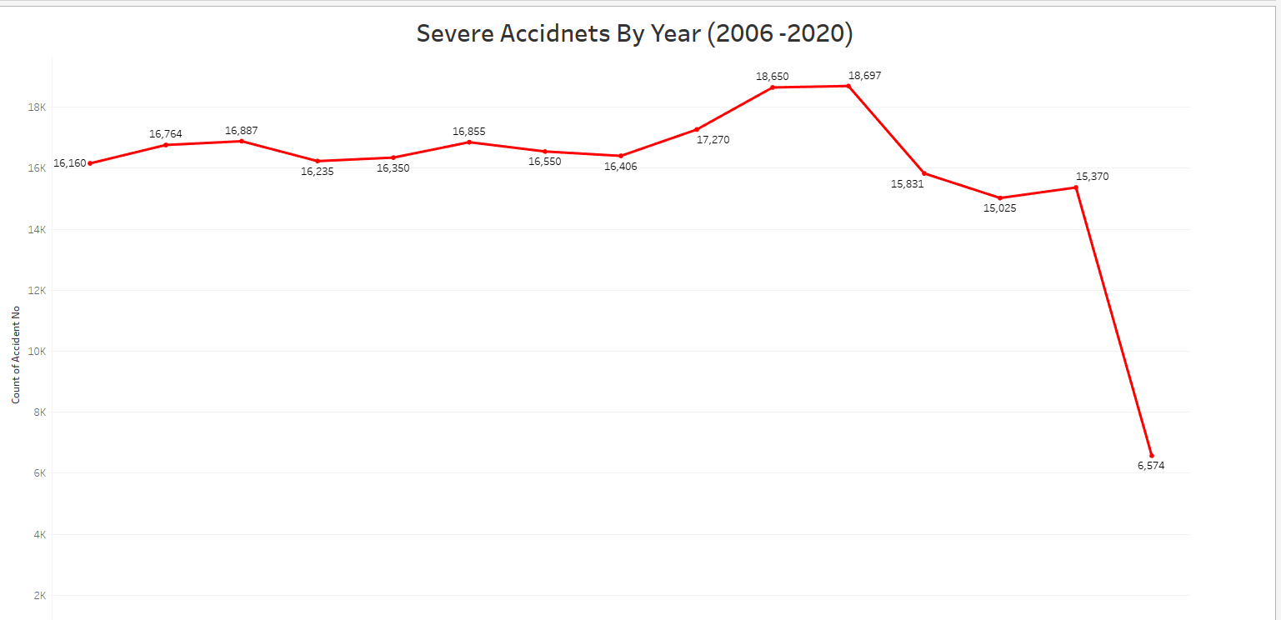
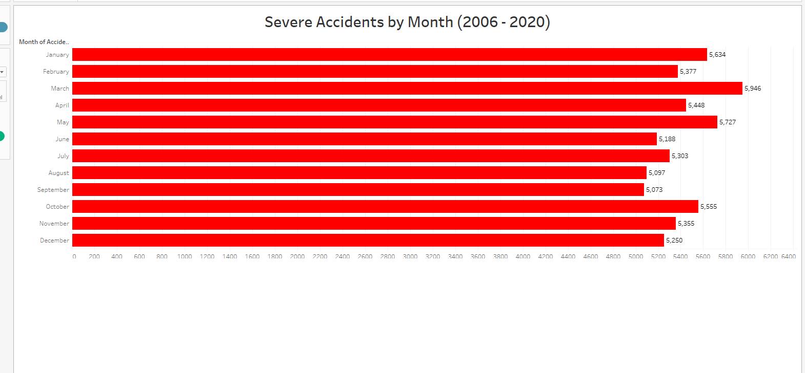
When do/did the most severe accidents happen?

Slide 8
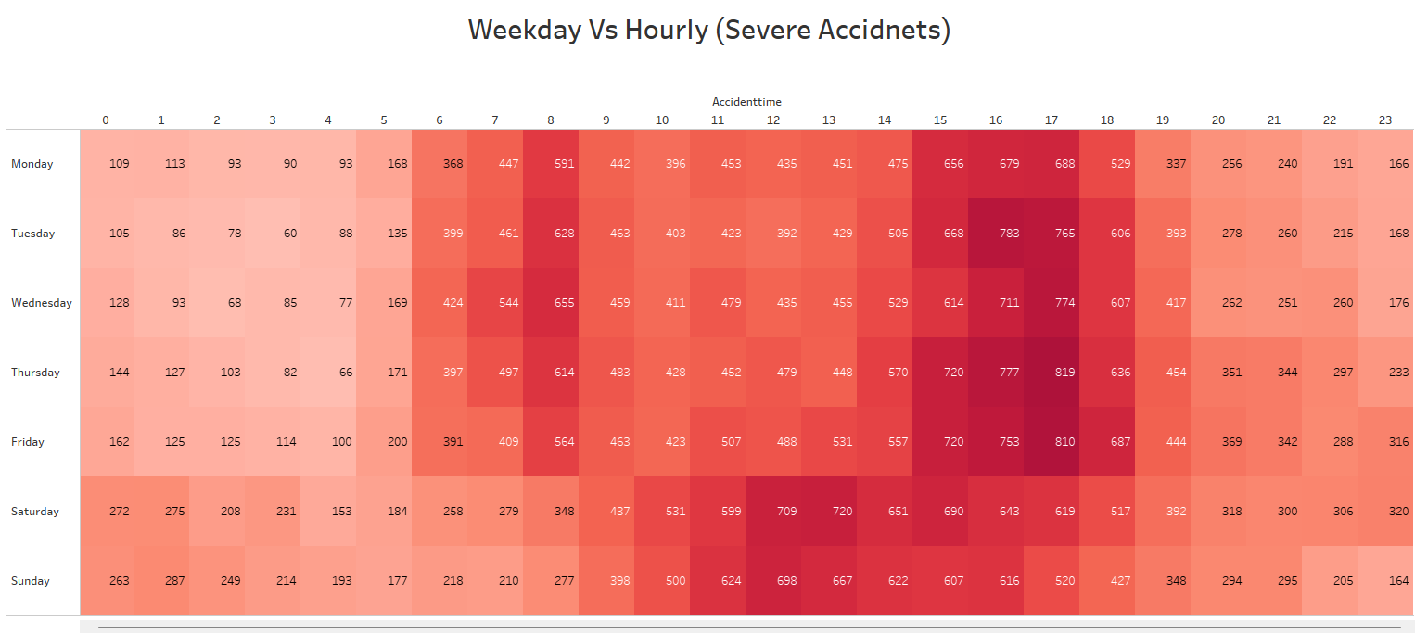
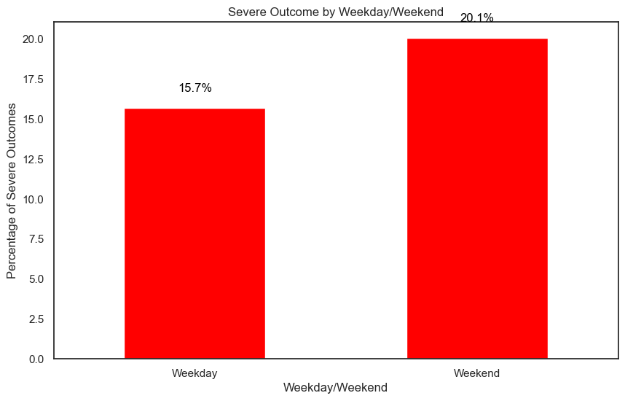
What Time and day do most Severe Accidents happen

Slide 9
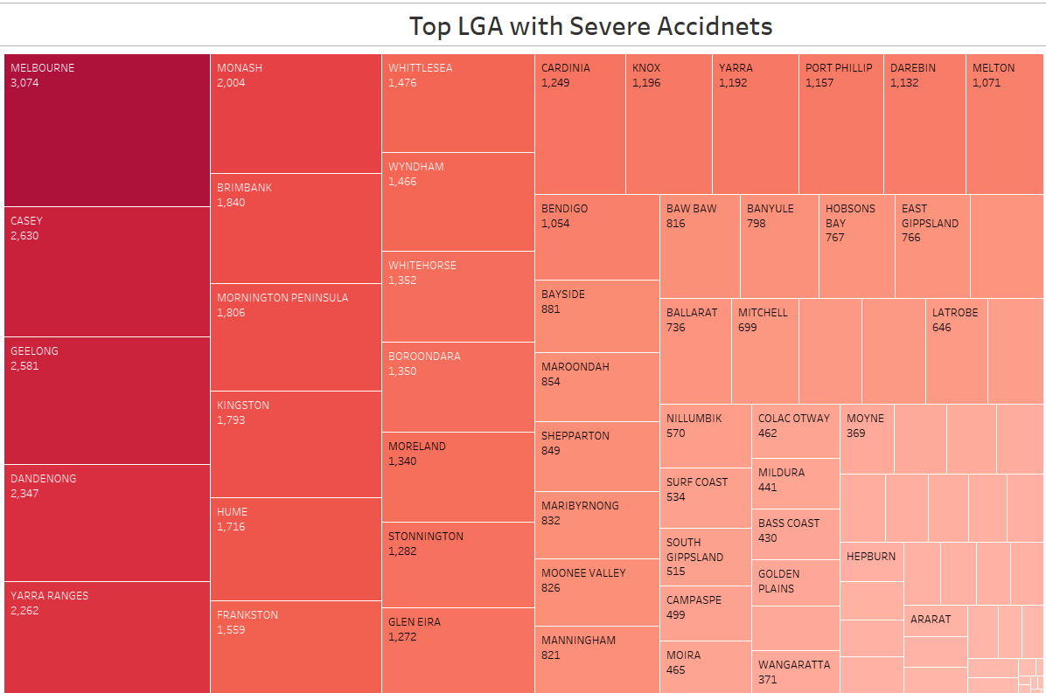
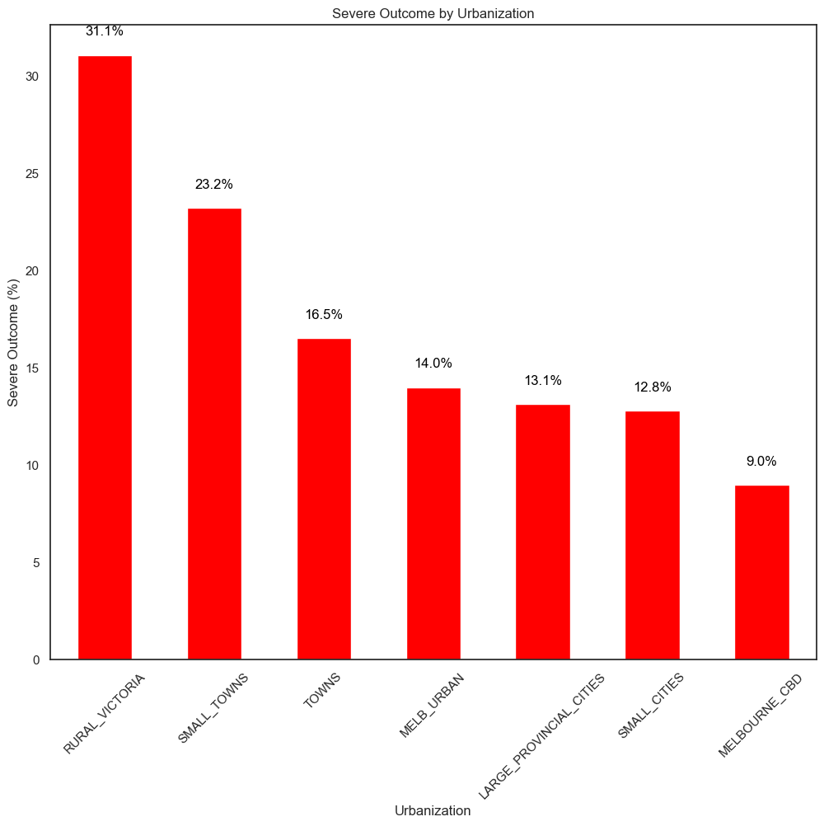
Where do most severe accidents occur ?

Slide 10
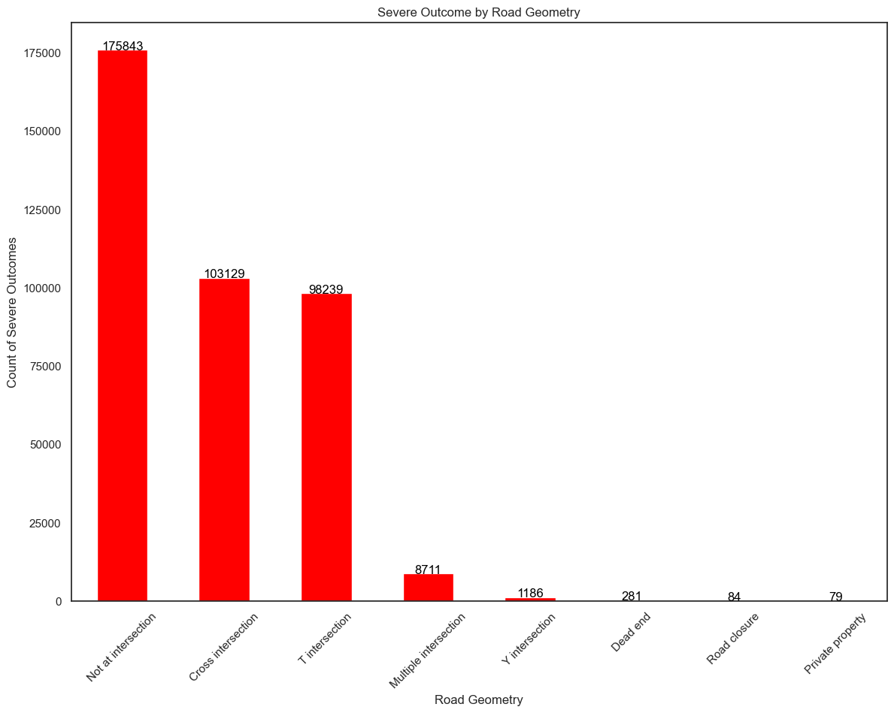
What Road Types/description led to severe outcomes
About 18,000 Severe accidents are on highways

Slide 11
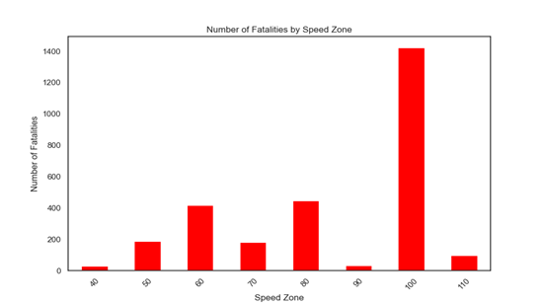
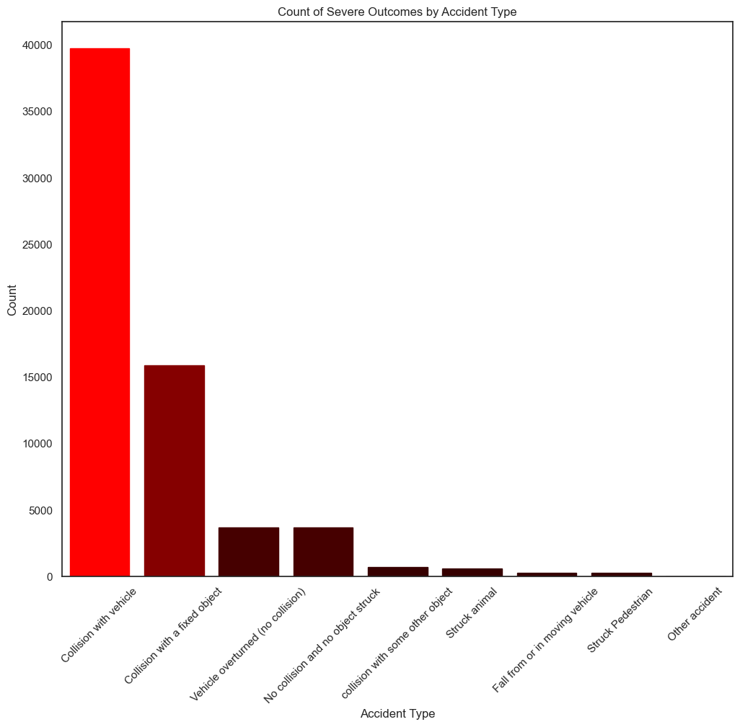
Speeds effect on accident severity and what types of accident lead to most severe outcomes

Slide 12
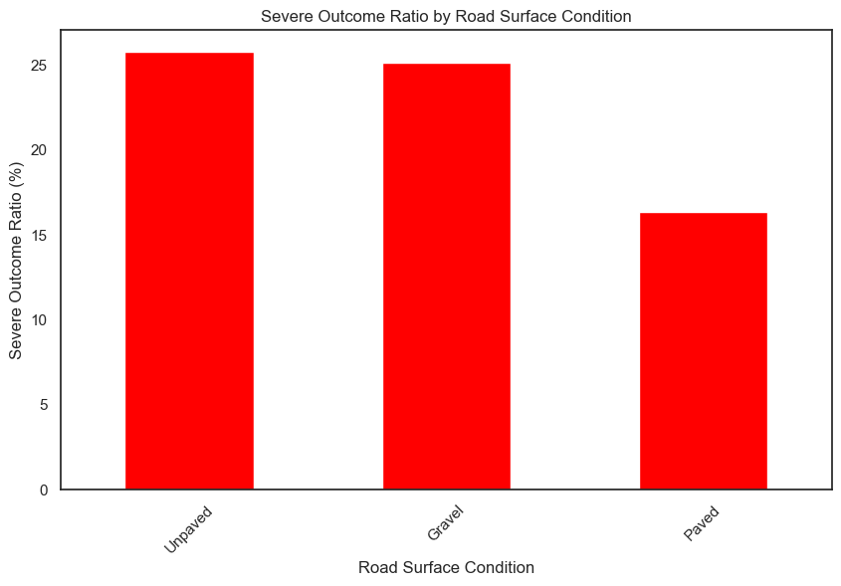
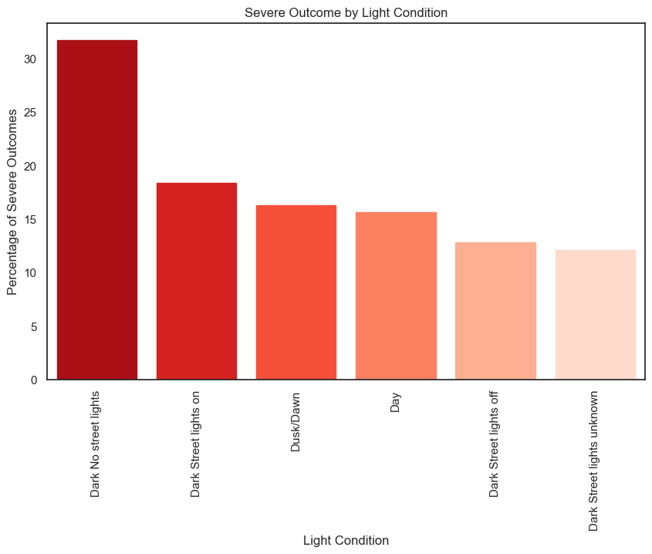
How does light and road condition effect accident Severity ??
(Mostly in Rural Areas !!!)

Slide 13
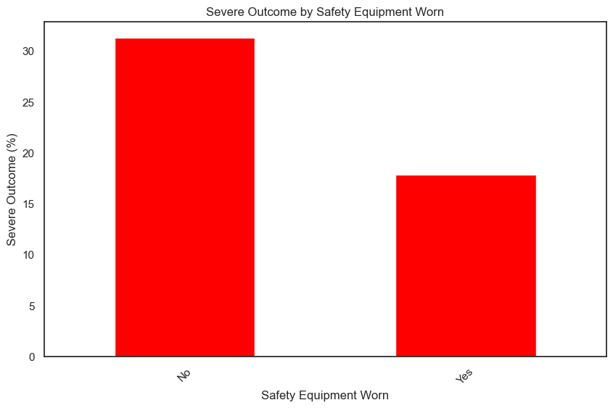

How Safety plays a big role in Road accidents
Over 30% of accident where safety equipment isn’t worn on roads, leads to severe outcomes

Slide 14
Recommendations for Solutions
Implement appropriate speed limits, enforce strict penalties for speeding, and use speed control measures to deter excessive speeding.
Prioritize driver safety in rural areas through proper urban planning and traffic calming measures.
Promote the use of safety equipment such as seat belts, child restraints, and helmets through increased awareness and public campaigns.
Improve street lighting in high accident areas such as rural areas to enhance visibility.
Develop weather-responsive road management strategies and provide real-time weather information to drivers during adverse conditions.
Regularly inspect and maintain road surfaces to prevent hazards and ensure a smooth driving experience in rural areas.
Implement targeted safety measures during weekends, including increased enforcement and public awareness campaigns, to address high-risk driving behaviors and alcohol-related incidents

Slide 15
Predicting accident severity using Machine Learning
Logistic regression is a statistical technique that predicts the probability of a categorical outcome, such as whether an accident will be severe or not, based on input factors
I analyzed my comprehensive dataset and developed a logistic regression model to estimate the probability of severe accidents.

Slide 16
Logistic regression methodology
The data preprocessing phase involved handling outliers, missing values, and skewness in the dataset.
One hot encoding and label encoding techniques were applied to further transform the data.
Data imbalance was addressed using two techniques: under sampling and SMOTE, resulting in two different datasets.
The regression analysis was conducted through several iterations, consisting of feature selection, model development and adjustment, and model assessment and validation. The final model utilized the under-sampling dataset.

Slide 17
Results

Slide 18
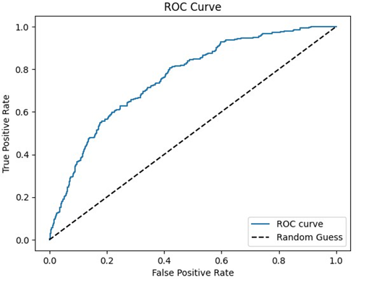
Best Selected Model
The final selected model for classification was "Under Sample Fatality > 0.65."
This model was trained on the under-sampled dataset while maintaining a classification threshold of 65%.
It demonstrated significantly improved performance in correctly classifying true positives compared to the baseline model.
The model also maintained accurate classification of true negatives and achieved a recall of 0.51, which exceeded that of other developed models. The AUC of 0.673 fell within an acceptable range.

Slide 19
Limitations
The limited availability of complete data was a significant limitation in this work.
The analysis did not yield significant findings, but it is expected that with more data, the models will provide more conclusive results.
Despite the limitations, the study aimed to gain insights into the relationships between incident causal factors and outcomes.
Understanding these relationships can help identify factors that may contribute to catastrophic events as well as those that may lead to less severe events.

Slide 20

Executive Summary
Objective: Build a high-precision model for predicting accident severity and identifying key contributing factors.
Importance: Reduce Severe accidents and implement targeted interventions.
Findings: Accurate predictions (76.6%) and key factors: speed zone, urbanization, Safety equipment worn, street light availability, weather conditions, and road surface conditions

